Slide 1
STEP BY STEP GUIDE TO EXPORT Facilitator: Beverly Johnson
EXPORT COMPLIANCE
JAMPRO, Jamaica 10.08.2017

Slide 2
WHAT IS EXPORT COMPLIANCE
An Export Management compliance programme to ensure that the Company (Exporter) comply with the rules of origin, transshipment and entry at destination
Export Compliance is more than choosing a suitable mode of transport
Export Compliance is more than find a buyer for your products or services

Slide 3
EXPORT COMPLIANCE
Requires you to meet all the appropriate steps which will ensure your goods meeting all the rules, standards and regulations of the importing Country
Failure to comply may result in
i. Goods being returned to exporting Country
ii. Seizure by the authorities and full disposal at the importers’ expense
iii. Imposed fines and penalties

Slide 4
EXPORT COMPLIANCE
Establish the Rules of Entry of the Import Country (eg. Permit, Licence etc)
Proper Classification of your shipment – use of Harmonised System Codes
Ensure you have done you due diligence of all persons within the export transactions
Compliance of the documents “called” into the transaction
The ‘Red Flags”

Slide 5
EXPORT COMPLIANCE THE EXPORT FLOW PROCESS
Prepared by Jampro

Slide 6
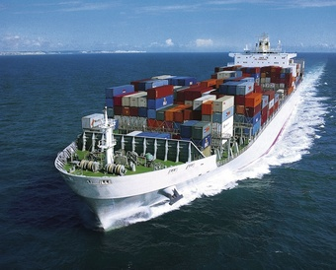
EXPORT COMPLIANCE Regardless of the Mode of Transport choosen your shipment is not deemed “Delivered” until the buyer is satisfied.

Slide 7
Beverlyj@jlbshipping.com Tel: 011 44 785 002 5582
EXPORT COMPLIANCE

